Slide 1
ICT-LAB FINAL PROJECT
WEB
DEVELOPMENT

Slide 2
OUR TEAM
MUHAMMAD NOOR
SHAHZAIB ALI
Muddassir asghar​
VIKRAM KUMAR​
Group Leader
KPK province details, Login Page, Kashmir/Gilgit Page
Home page ,About us page, Punjab Page, Theme, Layout
Province geographical history, Baluchistan details
Geographical history details, Sindh province

Slide 3
THEME & BASIC INTRO.
TOURISM IN PAKISTAN
A WEB SERVICE FOR TOURIST TO
EXPLORE PAKISTAN
Exploring different locations in Pakistan
different Provinces in Pakistan
Geographical history of different destinations in Pakistan
&

Slide 4
Why tourist web ?
Option to show the culture of Pakistan
Value add of Pakistan historical places internationally
Showcasing Pakistan's Beauty
Economic Impact
Creating Connections
Adventure and Exploration
Cultural Exchange

Slide 5
CAN THIS WEB SOLVE ANY SOCIAL ISSUES ?
YES
Because of …
Education and Awareness is been increased
By promoting Inclusivity and Diversity positive impacts falls on social
Promoting Responsible Tourism Guidelines
Positive relation with economic growth in Pakistan

Slide 6
WHAT Targeted AUDIENCE will be for this web?
Firstly international clients (tourist)
Secondly National clients
Educational institutes
Business clients (for research based trips)

Slide 7
LET’s DIVE INTO
WEBSITE !!

Slide 8
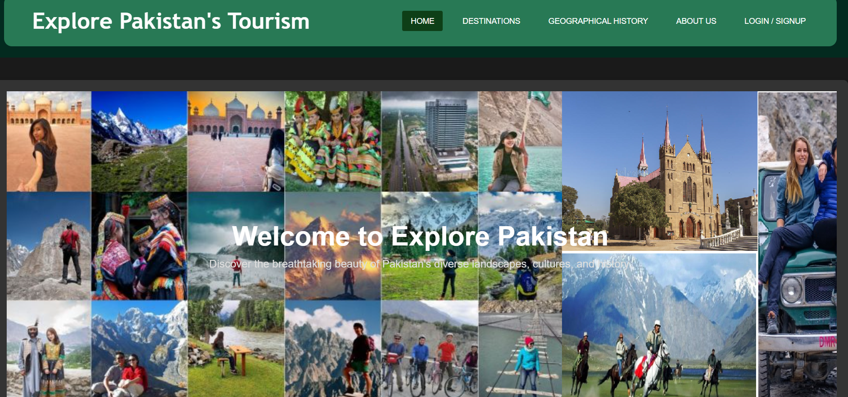
HOME PAGE
Home Page shows the overview and different destination pictures in the background with some navigation (Home, Destination, Geographical History, Login/Signup) buttons on the top bar.

Slide 9
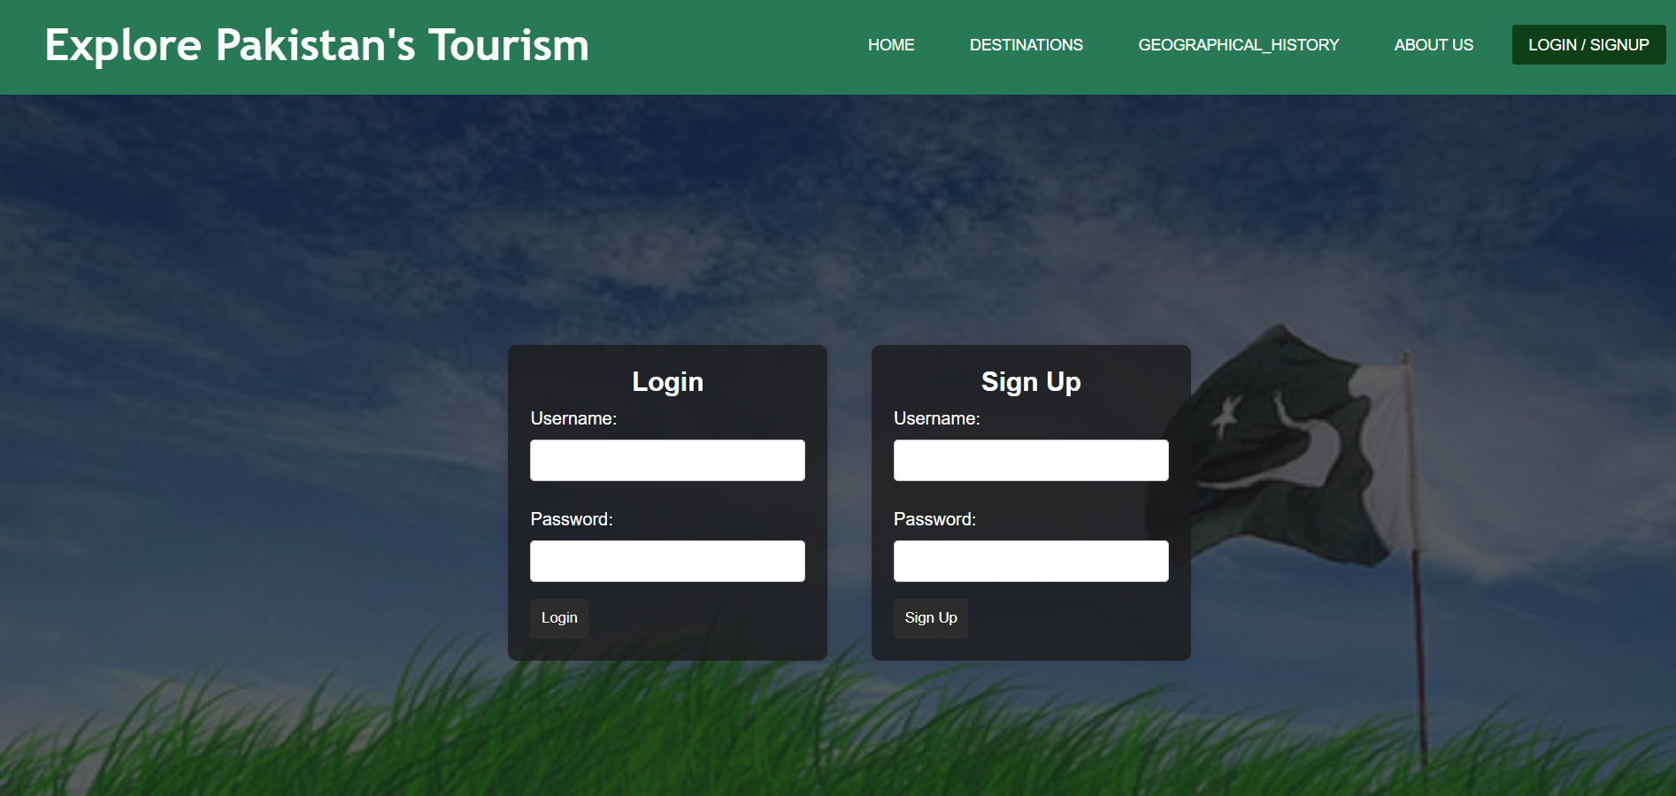
LOGIN PAGE
By clicking on the (login/signup) on the navigation bar there interface shows as login/signup page.

Slide 10
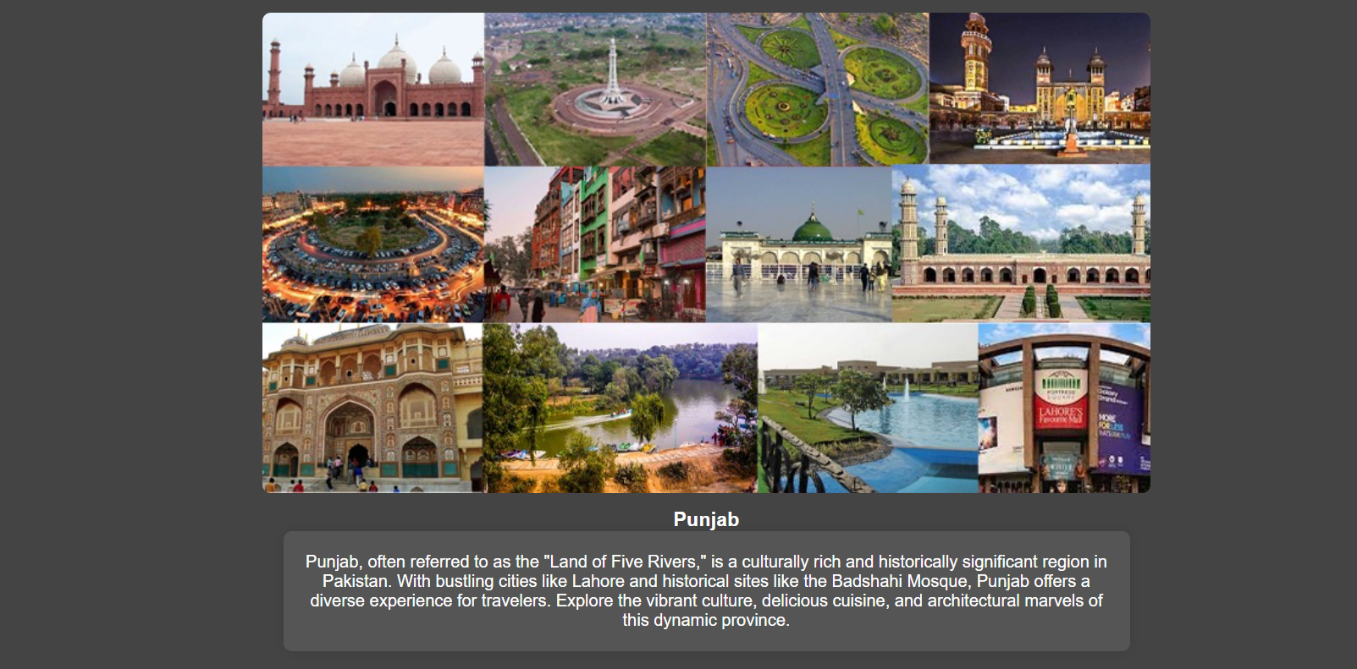
MAIN PAGE
Later on Main page has geographical information of the different places in the different provinces in the Pakistan, by clicking the links the website navigate to their respective provinces destinations history and packages.

Slide 11
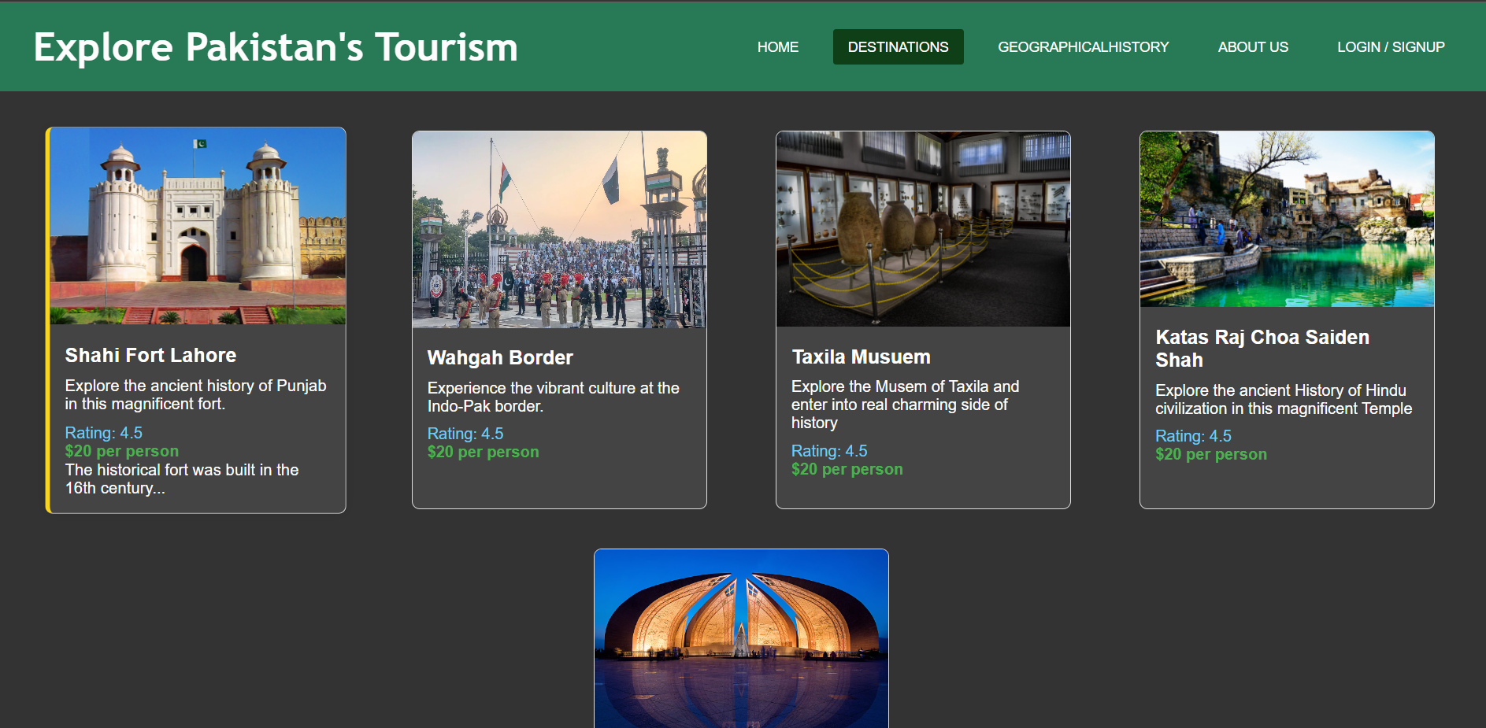
DESTINATION PAGE
Here is the sample display page for the packages for the destination of the different destination in the Punjab province.
Later on its is province by province, user defend and navigate easily.

Slide 12
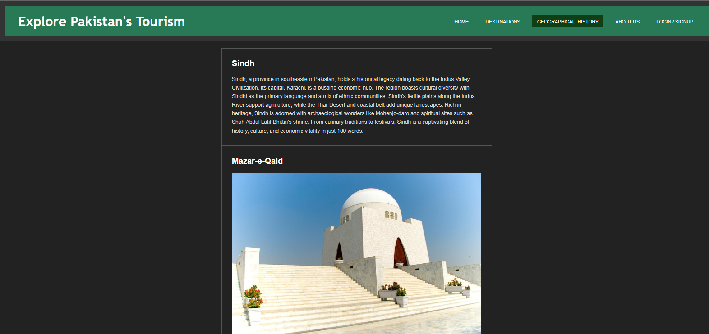
GEOGRAPHICAL HISTORY PAGE
By the tab of the geographical history the user can navigate to the different province destination’s background history.

Slide 13
REASONS BEHIND THE THEME COLORS …
Pakistan green patriotic look and feeling
Dark background color gives some professional look

Slide 14
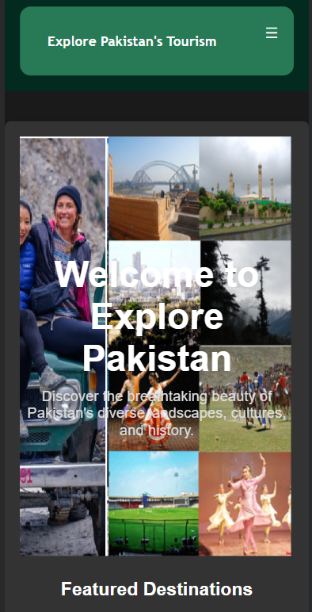
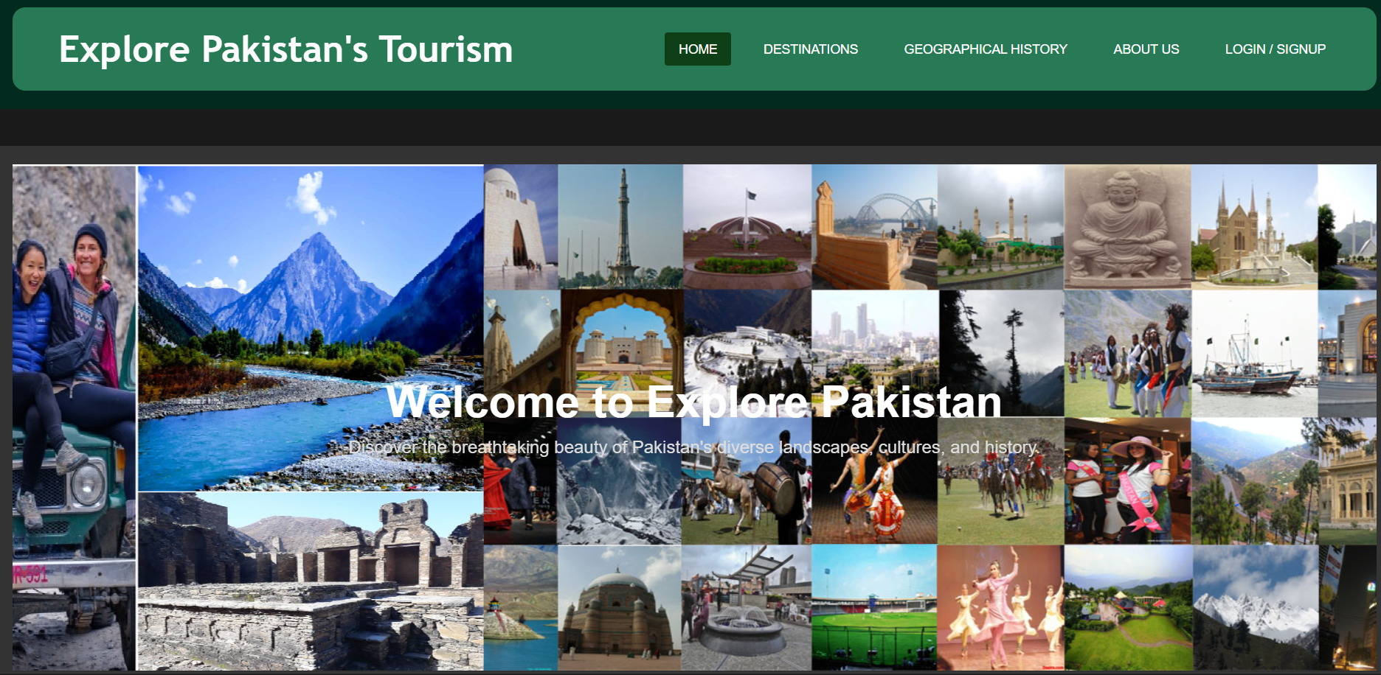
Responsive Design: (Partial)
We have created Responsiveness for small devices.

Slide 15
WHERE WE SEE OURSELF IN THE Future?
Expand Content and Coverage
Partnerships and Collaborations
Educational Outreach
Adaptability to Trends
Explore ourself different hidden destination
in Pakistan to showcase

Slide 16
THIS WAS ALL ABOUT OUR WEBSITE

Slide 17
THANK
ANY
queries ?
YOU
So MUCH

